Slide 1

What’s new in Angular 7?
Pandiyan Murugan
25-Oct-18

Slide 2
What’s new in this release?
New tooling changes, not a lot of new features
Focused on Ivy project (not a part of this release)
Rewriting angular compiler to make it even better
TypeScript 3.1 support
ScrollingModule & DragDropModule

Slide 3


Slide 4
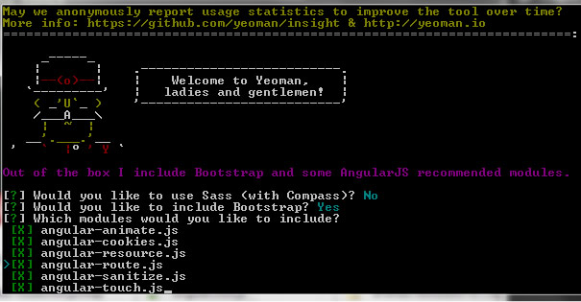
Prompts

Slide 5
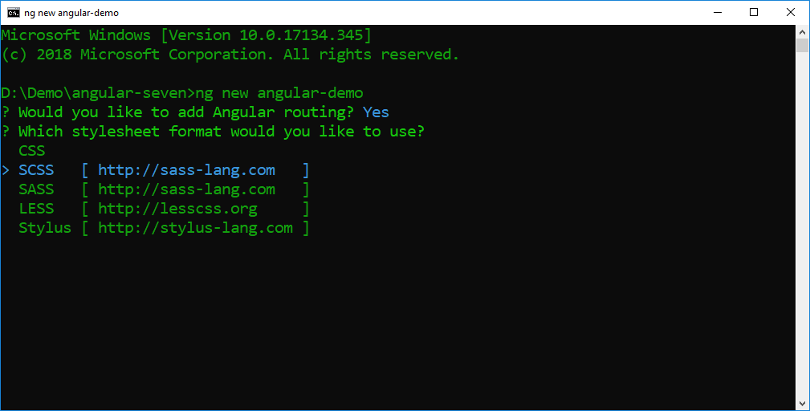
CLI prompts

Slide 6
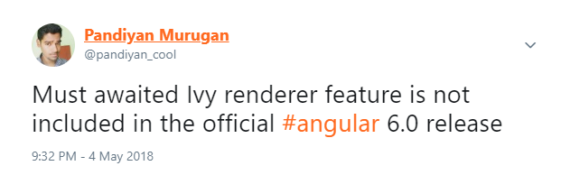
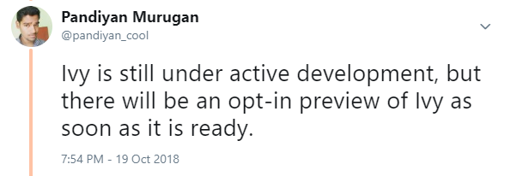
Ivy Renderer

Slide 7
Updated Dependencies
Typescript 3.1
RxJS is up to 6.3
Node 10 support

Slide 8
Angular Update
https://update.angular.io/
Update to v7 of the core framework and CLI by running ng update @angular/cli @angular/core in your terminal

Slide 9
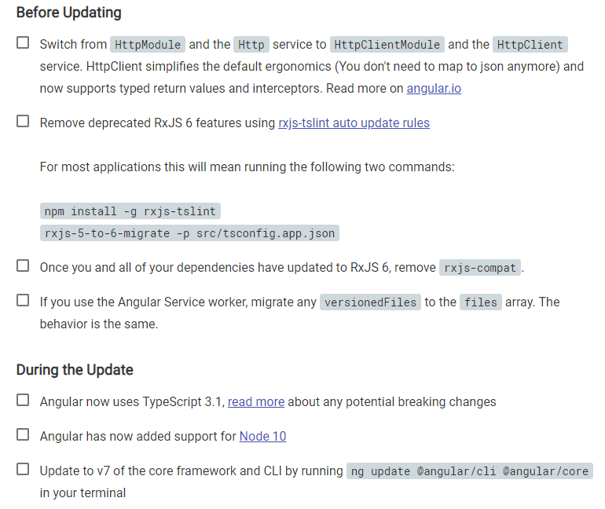

Slide 10
The Angular Material CDK
ScrollingModule
DragDropModule
cdk-virtual-scroll-viewport
Support for native <select> element in <mat-form-field>
Added <mat-action-list>, a list where each item is a <button>

Slide 11
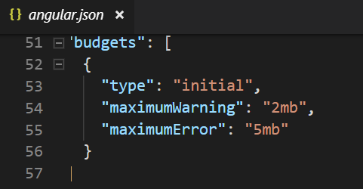

Performance
reflect-metadata polyfill in production
Bundle Budgets
Advantage of Chrome’s Data Saver features.

Slide 12
CLI features
A lot of flags have been added to various commands!

Slide 13
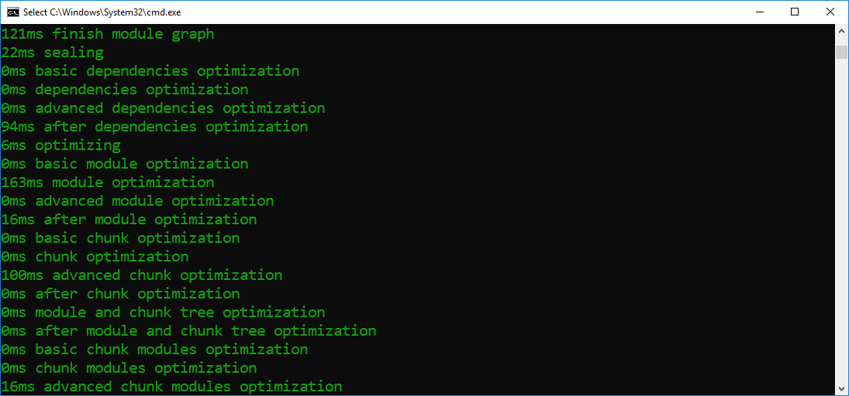
ng build --verbose
displays how much time each task took, how much each asset weighs, etc.

Slide 14
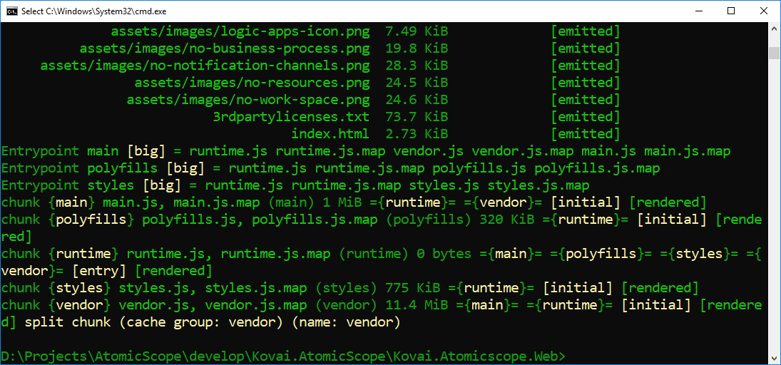

Slide 15
ng new
ng new atomicscope --no-interactive (no prompt at all)
ng new atomicscope --defaults (uses the default option of the prompt if it exists)
ng new atomicscope --no-create-application
workspace with the NPM, TypeScript, TSLint and Angular CLI configurations, but with no application (so no src and e2e directories).

Slide 16


Thanks, Keep supporting ☺
Subscribe to Efficient User
and click the bell icon.
Developer blogs
efficientuser.com
nullablereference.wordpress.com

